Slide 1

Caustic Design
Camille Boillet,
Patrick Engelhard

Slide 2
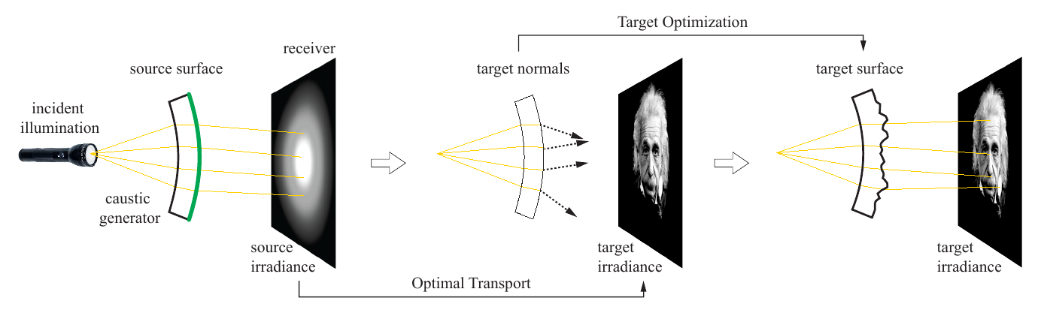
Algorithm Overview

Slide 3
Implementation steps
1. User I/O
2. Voronoi Generation
3. OTM computation
4. Natural Neighbor interpolation
5. Target optimisation
6. Simulation
7. Fabrication

Slide 4
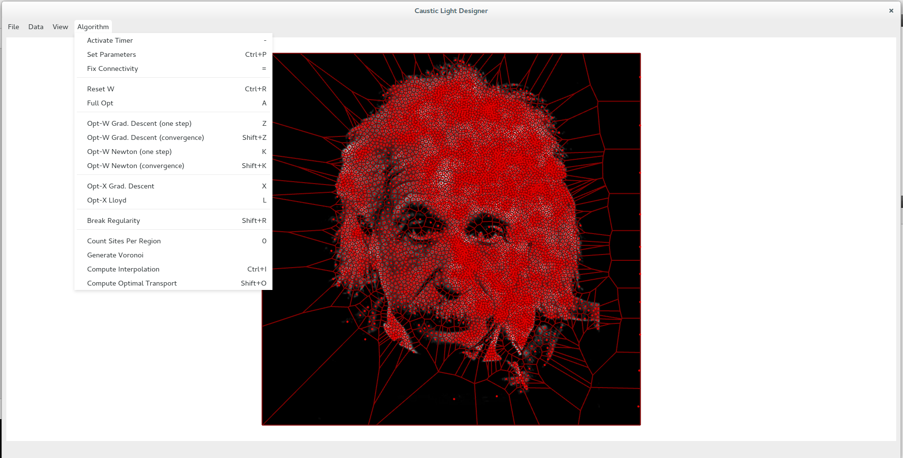
1. User I/O
GUI for user I/O implemented

Slide 5
2. Voronoi Generation
achieved | Next steps
Using Blue Generate random site based on image Assign pixel Llyod Optimisation | -

Slide 6
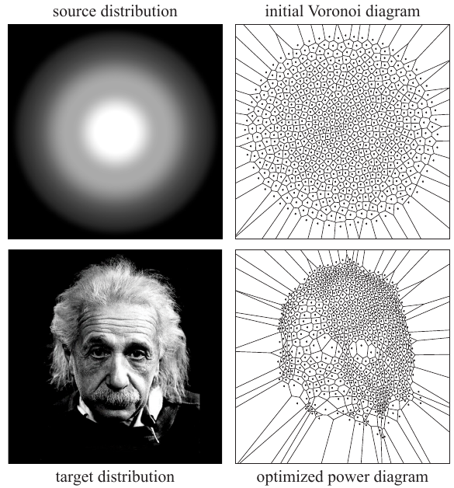
3. OTM computation
achieved | Next steps
Load target distribution Import l-bfgs librairy for optimisation | Implement optimisation function Multi-scale approach testing

Slide 7
4. Natural Neighbor interpolation
achieved | Next steps
Incident dataset insertion Nearest neighbors calculation | Weight vector computation Interpolation on the weighted Diagram

Slide 8
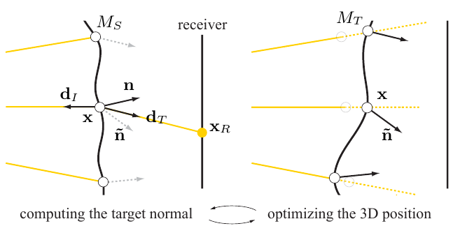
5. Target optimisation
achieved | Next steps
 | Weight vector computation Interpolation on the weighted Diagram

Slide 9
6. Simulation
achieved | Next steps
LuxRender (used for Ray Tracing) hands on | Apply target surface on mesh Simulation on LuxRender Simulation of noise on the mesh

Slide 10
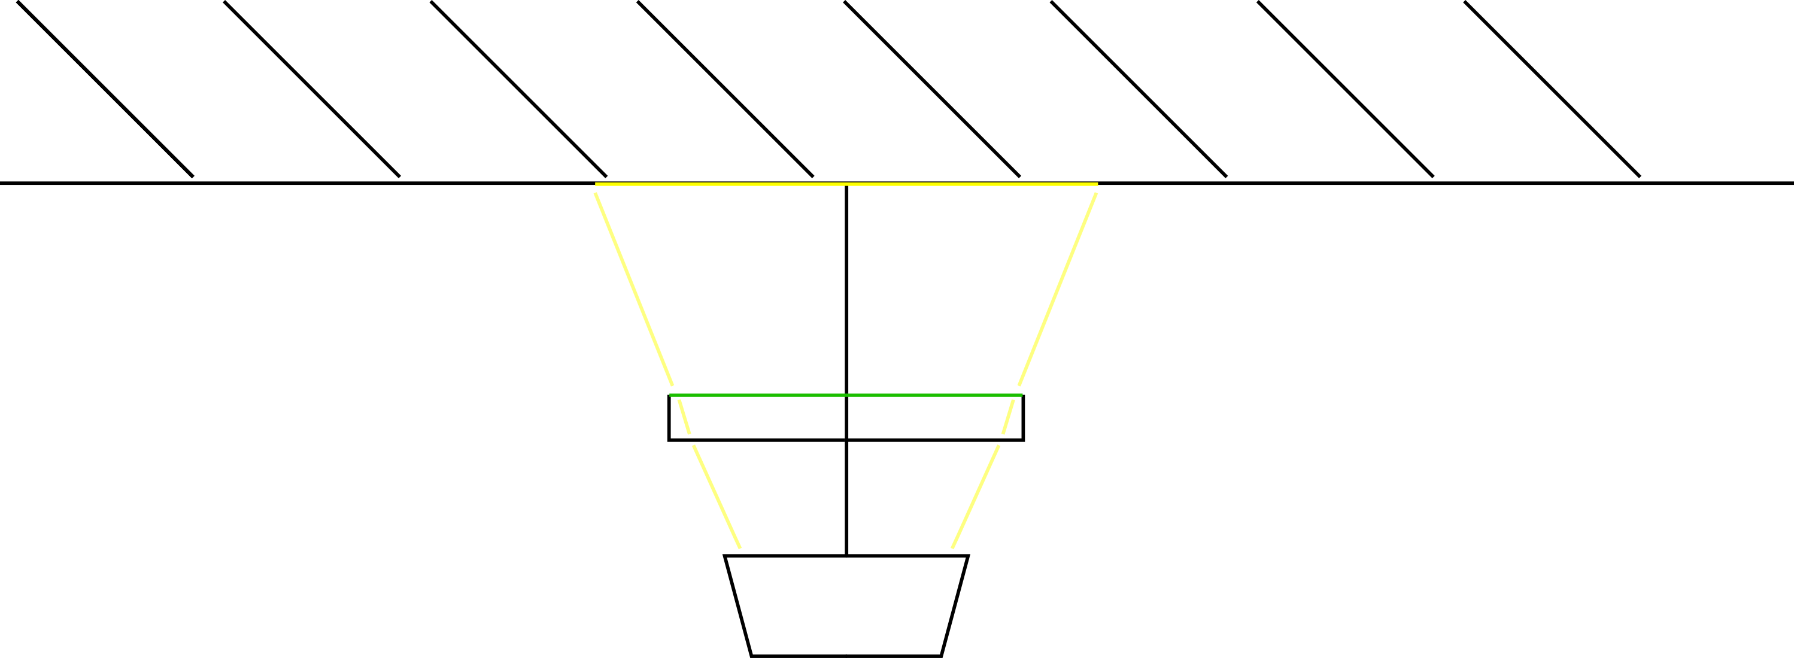
7. Fabrication
achieved | Next steps
- | Order material Milling machine hands on Manual ploishing Electrical installation

Slide 11
Time Schedule
Initial schedule | re-Schedule
● May 18: Target Specification (incl. Point-Singularities) First (Test-)Application using CGAL library Overall Plan of Application ● June 8: First version of Target Surface Computation ● June 15: Intermediate OTM Implementation ● June 22: Interpolation Target Surface Computation ● June 29: Full Implementation of Algorithm/Debugging | ● May 18: Target Specification (incl. Point-Singularities) First (Test-)Application using CGAL library Overall Plan of Application ● June 8: First version of Target Surface Computation ● June 15: Intermediate OTM Implementation ● June 22: Interpolation ● July 6: Target Surface Computation ● July 10: Simulation ● July 26: Fabrication, documentation

